Slide 1

Networked Software Systems Laboratory (NSSL) Projects
Presented by Dr. Jose Yallouz
winter 2026
mail: jose@technion.ac.il

Slide 2
NSSL Area of Expertise
Software
Distributed Systems
Algorithms
Operating System
Smart-Phone Programing
Crypto Currency
Artificial Intelligent
Network
Network Protocols
Routing Algorithms
Network Simulation
Data Center Topologies
Congestion Control
Network Security
Network Optimization

Slide 3
Network Laboratory Goals
Supervise and Provide Student Facilities for Student Projects in computer networking.
Teaching Laboratory Experiments of computer network.
Support Research of Faculty Members in computer network and distributed systems.

Slide 4






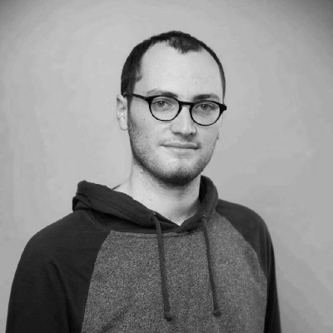


Laboratory Staff
Victor Kulikov
Software Engineer
Hovav Gazit
Chief Engineer
Jose Yallouz
Network Engineer
Tal Mizrahi
Network Expert
Felix Goldberg
Graph theory Expert
Henrique Kagan
Optimization Expert
Ilay Yavlovich
Graduate Student
Elisheva Shamash
Game-Theory Expert
Sorana Fraier
Cyber Expert

Slide 5

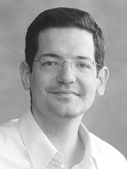


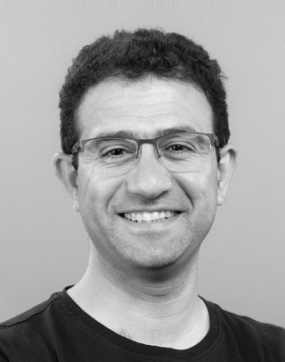





Faculty Members
Prof. Ariel Orda
Prof. Isaac Keslassy
Prof. Alejandro Cohen
Prof. Ori Rottenstreich
Prof. Mark Silberstein
Prof. Idit Keidar
Prof. Ittay Eyal
Prof. Dana Drachsler
Prof. Yoram Moses
Prof. Yuval Cassuto

Slide 6
Computer Network Laboratory Experiment
Wireshark and python (scapy) analyze
This lab introduces students to fundamental networking tools and concepts through practical experimentation. It includes hands-on exercises using Wireshark, a network protocol analyzer, scapy a Python program for creating and analyzing network traffic and Mininet, a network emulation platform.
Objectives:
Learn to monitor and analyze real network traffic using Wireshark, including filtering and interpreting packet data across different network layers.
Understand basic protocol structures (TCP/IP, UDP, ARP, ICMP).
Analyze how protocols such as ARP, ICMP and TCP function in practice, and observe routing decisions and message flows within virtual networks.
Analyzing TCP flow control and congestion control mechanisms.
Implementation of several network appliances such as traceroute, NAT and load balancer using scapy.

Slide 7



Laboratory Projects
Networking Projects
Cyber Projects
Network Simulation Projects
Evaluation of BBR congestion control algorithm
Network Algorithm Projects
Implementation of Connected Dominating Set algorithms.
Network Optimization projects
Load Balancing in Large Heterogeneous Systems
AI Related Projects
Synthesis of collective operations for Accelerating Distributed AI training
High-Performance Traffic Generation and Benchmarking on the NVIDIA BlueField DPU
RTTplay attack
Wi-Fi Protocol Attack Tool – SpyFi
QUIC Protocol Vulnerabilities.TT replay attack
Algorithmic game theory Projects
Student-Course Allocation using the Gale-Shapley Algorithm
Zero Carbon V2X Tariffs for Non-Domestic Customers
Block Chain Projects

Slide 8
Project Examples

Slide 9
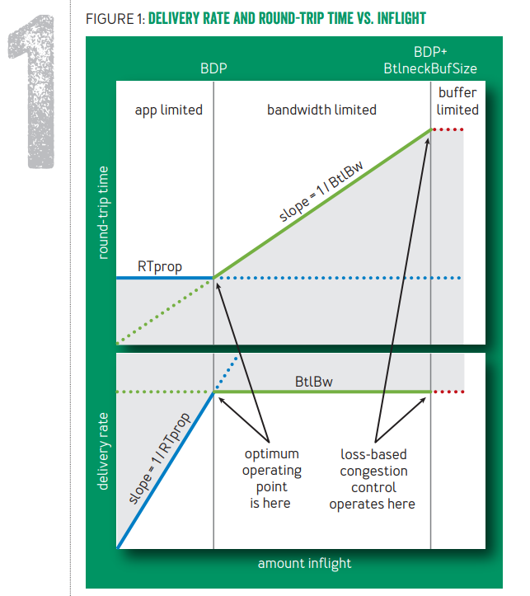
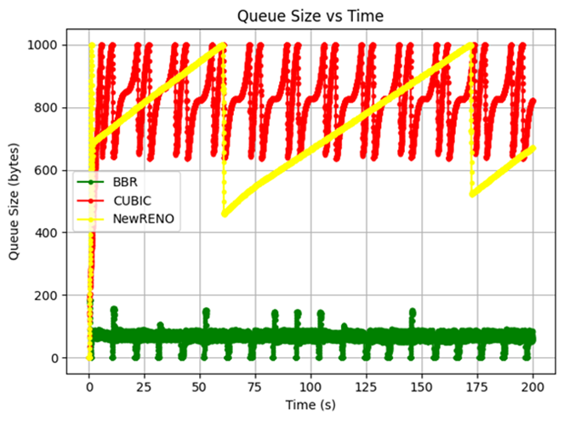
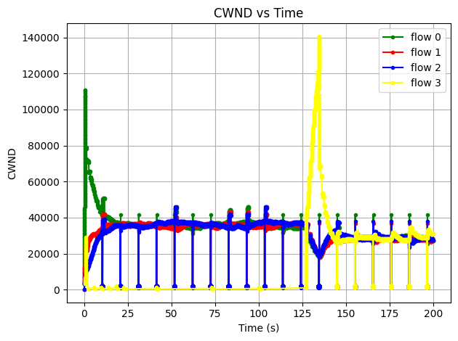
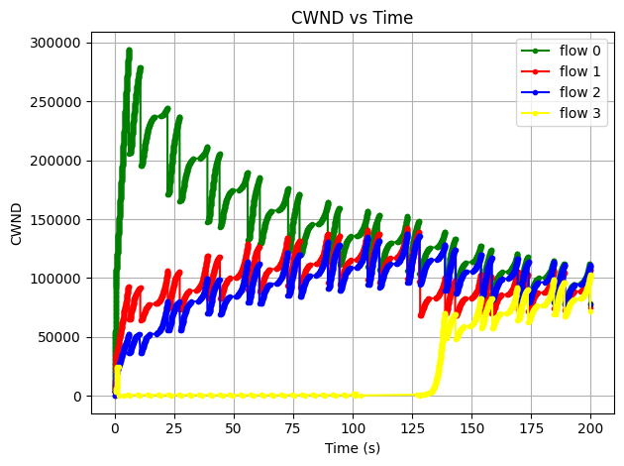
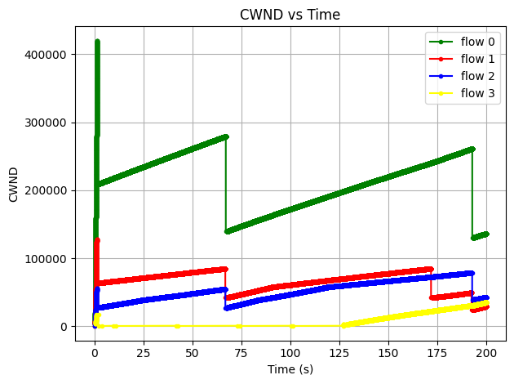
TCP -Congestion Control Algorithm: BBR Hanoch Katz & Liad Olier| Supervised by Jose Yallouz
Relying solely on packet loss can lead to unnecessary delays. Such algorithms tend to fill the bottleneck bandwidth and build up queues until loss occurs, triggering a window reduction. While this maximizes throughput, the resulting queuing causes high RTT, making it a suboptimal operating point.
BBR
Cubic
Newreno
Queues Comparison

Slide 10
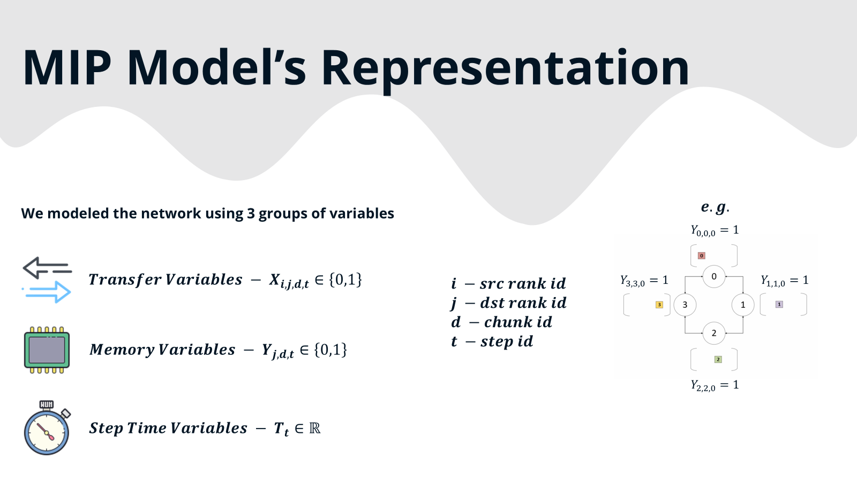
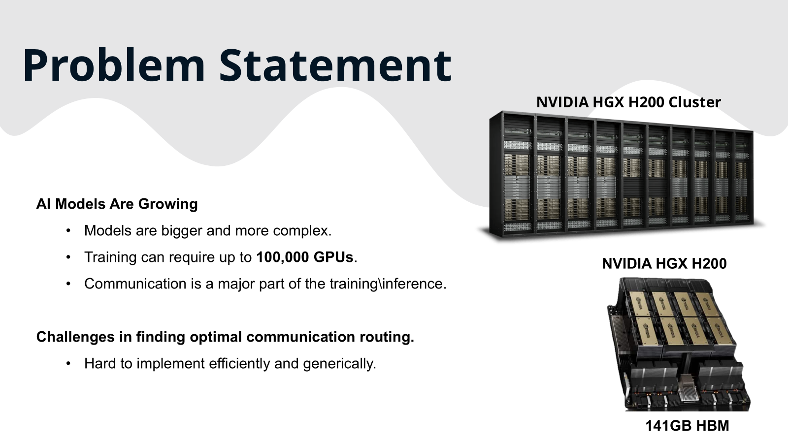
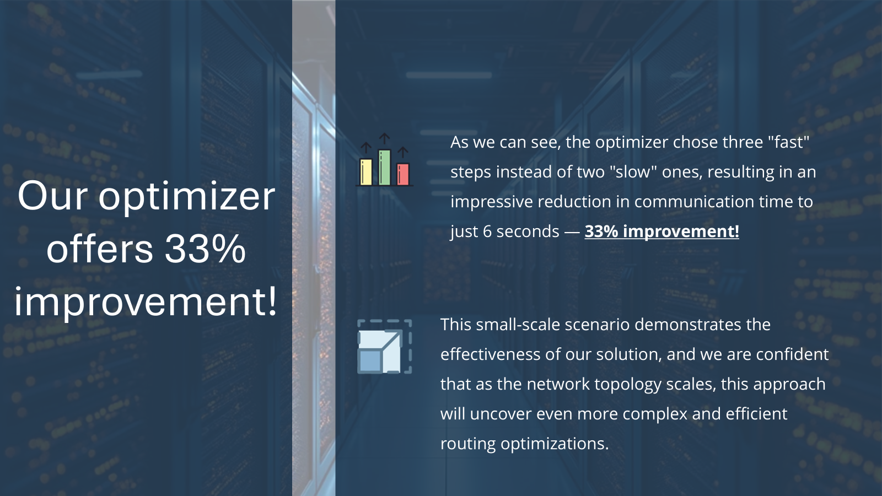
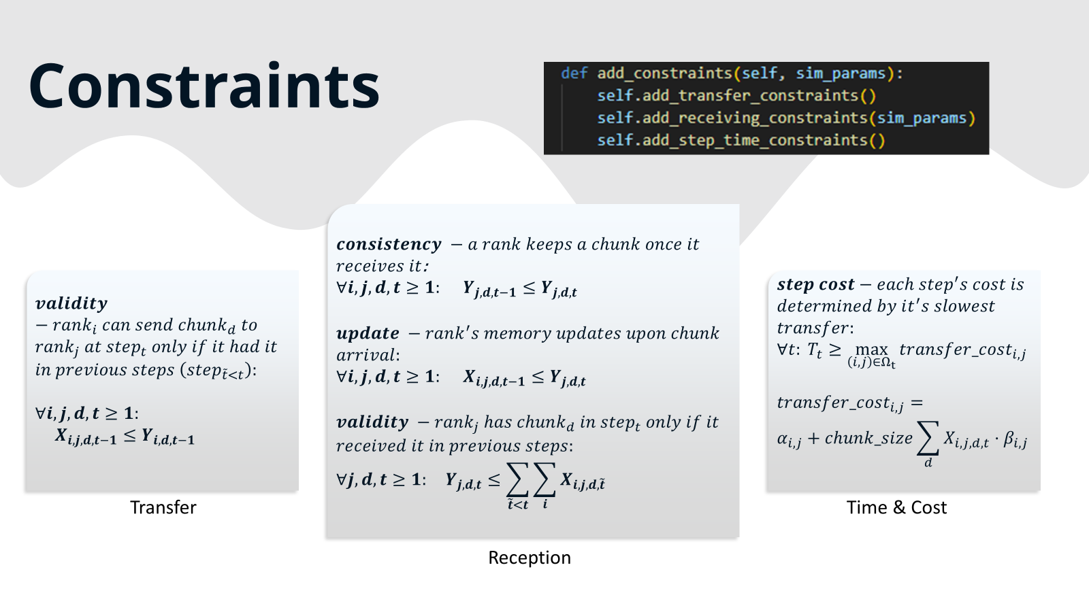
Network Optimization Framework for Inter-Accelerator Communication in Distributed AI Dor Yefet and Nadav Zohar| Supervised by Rami Cohen

Slide 11
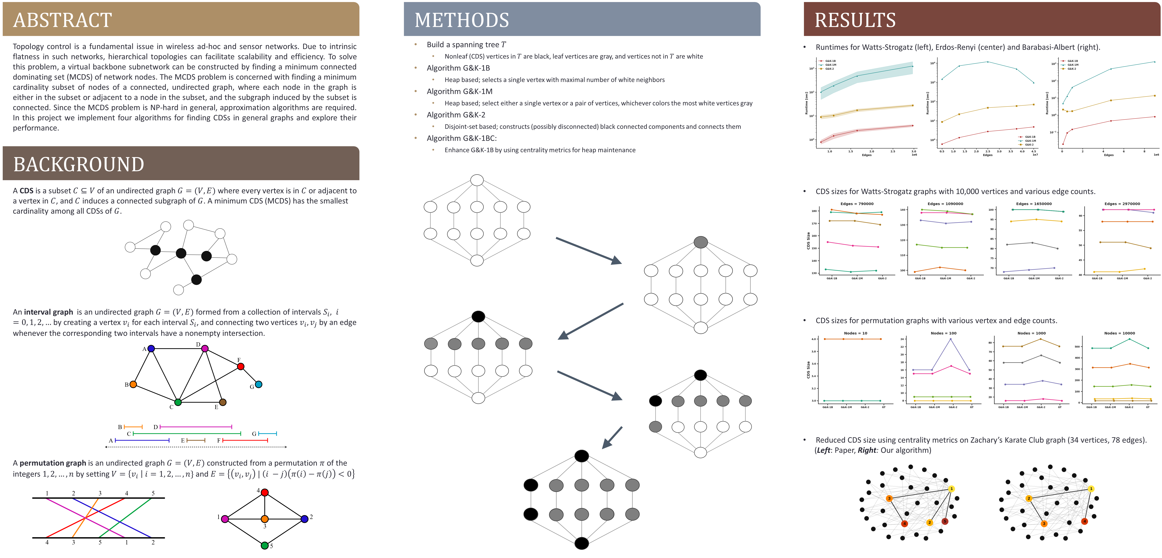
Connected Dominating Set Algorithms in NetworkX Gal Michaeli, Daniel Ben Shlush | Supervised by Felix Goldberg

Slide 12
Project List
Please contact jose@technion.ac.il for any question.

Slide 13
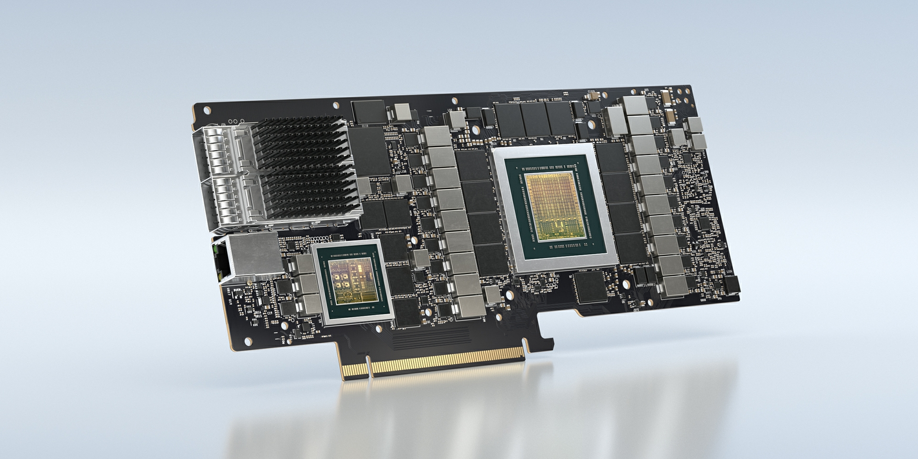

High-Performance Traffic Generation and Benchmarking on the NVIDIA BlueField DPU
The emergence of Data Processing Units (DPUs), such as the NVIDIA BlueField, is transforming cloud and data center infrastructure by offloading networking, security, and storage tasks from the host CPU. Accurate performance evaluation of these offloaded functions requires generating network traffic at ultra-high speeds—often line rate (up to 100/200 Gb/s). Traditional host-based traffic generators introduce unacceptable overheads and cannot saturate the DPU's links. This project proposes the design and implementation of a custom, high-performance packet generator running directly on the BlueField DPU's embedded Arm cores, leveraging the NVIDIA DOCA SDK and DPDK for hardware-accelerated packet transmission. The generator will be used to benchmark the DPU’s packet processing capabilities and quantify the true offload performance.
Objectives:
Framework Setup: Successfully configure the BlueField Arm complex with the required development environment, including the NVIDIA DOCA SDK and DPDK.
Hardware-Accelerated Transmission: Implement the packet transmission logic using DOCA APIs to ensure zero-copy and direct hardware access.
Near Line-Rate Performance: Achieve measured throughput performance that is at least 80\% of the DPU's maximum physical link speed (e.g., 80 Gb/s for a 100 Gb/s link) for minimum-sized packets.
Benchmarking and Evaluation: Latency Measurement, Performance Comparison, Resource Utilization.
Supervisor: Zuntz Igal igalz@technion.ac.il
Prerequisites: COMPUTER NETWORKS AND INTERNET 1 (044334)

Slide 14

Optimizing Quantum Network Connectivity via Entanglement Swapping and Distillation
Background
Quantum networks enable the distribution of entanglement between distant nodes, forming the foundation for applications such as quantum key distribution, distributed quantum computing, and quantum sensing. However, direct entanglement generation between distant nodes is often infeasible due to channel losses and noise. Two essential operations—entanglement swapping and entanglement distillation—enable indirect and higher-fidelity entanglement generation across large-scale quantum networks.
Entanglement swapping allows two nodes with no direct quantum link to share entanglement via intermediate nodes.
Entanglement distillation improves the quality (fidelity) of shared entanglement by consuming multiple noisy entangled pairs to produce fewer high-fidelity ones.
The interplay between these two operations is at the foundations of routing protocols in future quantum networks, and would determine the connectivity and performance of the entire quantum network. Developing an algorithmic framework that optimally sequences and combines these operations can significantly enhance the efficiency of quantum communication networks.
Project Objectives
The main goal of this project is to design and evaluate an algorithmic scheme that maximizes entanglement connectivity among quantum nodes by optimally orchestrating entanglement swapping and distillation operations for multi-users case. Specific objectives include:
Modeling the quantum network as a graph of quantum nodes and links with multi-users demands.
Designing heuristics to select the best sequence of swapping and distillation operations

Slide 15

Implementing Minimum Cost Flow Algorithms Using the Gurobi ILP Solver: A Performance Evaluation
The Minimum Cost Flow problem is fundamental in network optimization, with applications in transportation, logistics, supply chains, and telecommunication. While classical algorithms are well-studied, modern ILP solvers such as Gurobi offer powerful general-purpose tools for solving such problems efficiently. This project investigates whether Gurobi, when used with ILP formulations, can compete in performance with specialized algorithms and how it scales with problem size and structure.
Objectives:
Formulate classical Minimum Cost Flow (MCF) problems as Integer Linear Programs (ILPs).
Implement these formulations using the Gurobi optimization solver.
Compare the performance of Gurobi-based solutions with classical combinatorial algorithms (e.g., Successive Shortest Path, Cycle-Canceling).
Evaluate scalability and efficiency on synthetic and real-world benchmark datasets.
Supervisor: Henrique Kagan <henriquek@technion.ac.il>
Prerequisites: Algorithms and Data Structures (44268)

Slide 16
Load Balancing in Large-Scale Heterogeneous Systems With Multiple Dispatchers
Large-scale heterogeneous computing systems are widely used in cloud computing, high-performance computing, and distributed networks. Effective load balancing is critical for optimizing system performance, minimizing latency, and maximizing resource utilization. This project aims to design and evaluate various load-balancing strategies in heterogeneous systems with multiple dispatchers. By developing and testing different dispatching and load distribution mechanisms, the project will provide insights into improving system efficiency.
Objectives:
To understand and analyze the challenges of load balancing in heterogeneous systems.
To design and implement different load-balancing algorithms.
To evaluate and compare performance metrics such as response time, system throughput, and load distribution.
To explore the impact of multiple dispatchers on overall system efficiency.
Supervisor: Henrique Kagan <henriquek@technion.ac.il>
Prerequisites: COMPUTER NETWORKS AND INTERNET 1 (044334)

Slide 17

Compute & Communicate: A Fused Approach to AI Acceleration
Training and running massive AI models, like Gemini or ChatGPT, requires immense computational power spread across thousands of specialized accelerator chips. A major performance bottleneck in these large-scale systems is not the computation itself, but the communication between the chips. Collective operations, such as All-Reduce and All-to-All, are the fundamental communication patterns used to synchronize and share data (like model weights and gradients) across the system. Traditionally, these operations are treated as distinct steps: first, you compute, then you communicate. This can lead to valuable accelerator time being wasted, with powerful compute units sitting idle while waiting for data to arrive.
As an example, traditional distributed training might use the following sequence: all accelerators compute, then they all stop to communicate (e.g., via All-Reduce), and only then do they all resume computing to update the model. This "stop-and-wait" approach wastes valuable time. A fused collective would break this pattern by intelligently interleaving the tasks, e.g. by allowing an accelerator to start the weight update computation using partial results of the All-Reduce before the global communication is fully finished. By overlapping these tasks, we hide communication latency behind useful computation, significantly speeding up the entire training loop.
What if communication could be intelligently interwoven with computation, effectively hiding its cost? This project explores that exact question.
Key Activities
Architectural Analysis: Analyze the data flow graphs of different AI model blueprints to identify their fundamental communication requirements.
Custom Collective Design: Implement a set of specialized, fused collective operations tailored to the patterns you identified.
Optimization & Simulation: Use optimization tools to find the optimal schedule for your new collectives and simulate their performance, proving their advantage over traditional methods.
Skills & Outcomes
You'll learn: The deep connection between AI model design and system performance, adaptive algorithm design for parallel computing, and how to apply optimization theory to real-world problems.
You'll need: Strong Python skills, a good grasp of algorithms, and a keen interest in AI systems or computer architecture. Hands-on experience with AI frameworks like TensorFlow or PyTorch, and familiarity with communication libraries like NCCL, is a major plus.
Supervisor: Rami Cohen, rc@technion.ac.il, https://sites.google.com/view/ramicohen/

Slide 18
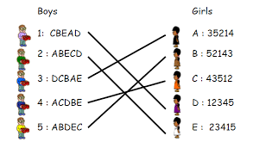
Student-Course Allocation using the Gale-Shapley Algorithm
The assignment of students to capacity-constrained courses is a classic example of a Many-to-One Matching problem. The goal of this project is to design, implement, and analyze an algorithm that finds a "fair" and stable matching between students and courses, based on the Stable Matching Problem (SMP) model and utilizing the Gale-Shapley Algorithm (GSM).A Stable Matching is one in which no "Blocking Pair" exists—meaning, there is no unassigned student and course where both would prefer to be matched with each other over their current assignment partners (or lack thereof). In our model, students rank their preferences for courses, and courses (or the faculty) rank their preferences for students (e.g., based on previous grades or seniority).The main objective of the project: To demonstrate the practical application of the algorithm to an academic system and theoretically prove the properties of the resulting matching.
Objectives:
Algorithmic Development: Program the paper algorithm that implements the Gale-Shapley mechanism for matching students to courses (with capacity constraints).
Dataset Collection: Collect the dataset from the Technion relevant departments.
Practical Solution: Run the algorithm on a simulated dataset to find the resulting student-course matching.
Stability Proof: Theoretically and/or empirically prove that the matching obtained by the algorithm is necessarily a stable matching.
Supervisor: Elisheva Shamash <elisheva.shamash@gmail.com>
https://www.jstor.org/stable/pdf/2312726.pdf

Slide 19
Allocating Energy Trading to Electric Vehicles via V2G (Vehicle-to-Grid) based on VCG
With the increasing adoption of Electric Vehicles (EVs) and renewable energy sources, energy demand management becomes critical. This project explores the integration of fleets of EVs into energy trading markets through Vehicle-to-Grid (V2G) technology. V2G technology facilitates the bidirectional exchange of electricity, enabling EVs to discharge energy back to the grid during peak hours and recharge during off-peak hours. The rapid rise in EVs presents an opportunity to use them not only as transportation means but also as energy storage units. Efficient energy trading using V2G can reduce electricity costs, support grid balancing, and enhance renewable energy utilization. This study introduces a mechanism for allocating energy trading contracts to EVs in an efficient manner.
1. Problem Statement
Despite technological advances in V2G, there is a lack of efficient allocation mechanisms for energy trading EVs and the grid, and specifically between fleets of EVs and the grid, that consider user preferences, and grid demands.
This project addresses how to optimally allocate energy trading opportunities to fleets of EVs using an intelligent system that ensures efficiency and grid reliability.
V2G enables bidirectional energy flow between EVs and the power grid, allowing EVs to act as both energy consumers and suppliers. This study aims to design and simulate an energy allocation model that optimizes energy trading between fleets of EVs and the grid. A simulation-based approach is used to evaluate the effectiveness of the model during different parts of a day.
2. Objectives
Demonstrate the practical application of the algorithm described in the paper " Zero Carbon V2G Tariffs for Non-Domestic Customers " via implementation.
3. Detailed Tasks and Methodology
Read paper "Zero Carbon V2G Tariffs for Non-Domestic Customers"
You should program the algorithm described in the paper "Zero Carbon V2G Tariffs for Non-Domestic Customers" Chapter 3 in Python, ensuring the code is modular, well-documented, and readable.
Run the above code using:
data from U.K: https://www.epexspot.com/en/market-results.
synthetic data concerning fleets' energy availability and energy costs (explain how this data was created).
Create a case study with 5 fleets, each with 10 EVs (adjustable) for real-world scenarios using the above code and data.
Supervisor: Elisheva Shamash <elisheva.shamash@gmail.com>

Slide 20

Analysis of Large-Scale Internet Traffic Dynamics: Flow Size, Burstiness, and Load Characterization
This project proposes a detailed, academic analysis of large-scale Internet traffic characteristics using the Anonymized Two-Way Traffic Packet Header Traces from the CAIDA passive_2025_pcap_100g dataset. Leveraging this real-world data, students will implement a robust flow-based analysis pipeline to characterize three fundamental network properties: flow size distribution, traffic burstiness, and network load (utilization). The primary output will be an in-depth Insight Report providing quantitative findings critical for modern network design, capacity planning, and anomaly detection research.
Project Objectives:
Data Processing: Develop and implement tools to efficiently parse the CAIDA PCAP header files, define network flows (e.g., using the 5-tuple: Source IP, Destination IP, Source Port, Destination Port, Protocol), and extract relevant time-series data.
Flow Size Analysis: Quantify and model the distribution of flow sizes (packet count and byte count) using statistical methods like Cumulative Distribution Functions (CDFs) and fitting to models like the log-normal or heavy-tailed (Pareto) distribution.
Burstiness Characterization: Analyze traffic variability across multiple time scales (e.g., 10ms, 100ms, 1s) using metrics such as the Peak-to-Mean Ratio (PMR) of the data rate and the variance of inter-arrival times.
Load and Utilization Assessment: Calculate and visualize the mean and peak link utilization (load) over defined sampling windows (e.g., 5-minute intervals) to determine periods of congestion and inform upgrade strategies.
Insight Report Generation: Compile all findings into a professional technical report that discusses the implications of the observed traffic dynamics for network operations and future research.
Supervisor: Jose Yallouz <jose@technion.ac.il>
Prerequisites: COMPUTER NETWORKS AND INTERNET 1 (044334)

Slide 21

Implementation of network algorithms in networkx
The primary goal of this project is to explore, implement, and analyze various network algorithms using the NetworkX library in Python. The project aims to enhance understanding of network structures, algorithmic efficiency, and real-world applications in graph theory and network science.
Objectives:
Literature review on network algorithms and NetworkX.
Implementation of selected algorithms using NetworkX.
Validation through synthetic and real-world datasets.
Performance benchmarking and comparative analysis.
Contribution of the code to Networkx Open Source
Supervisor: Felix Goldberg <felix.goldberg@gmail.com>
Prerequisites: COMPUTER NETWORKS AND INTERNET 1 (044334)

Slide 22
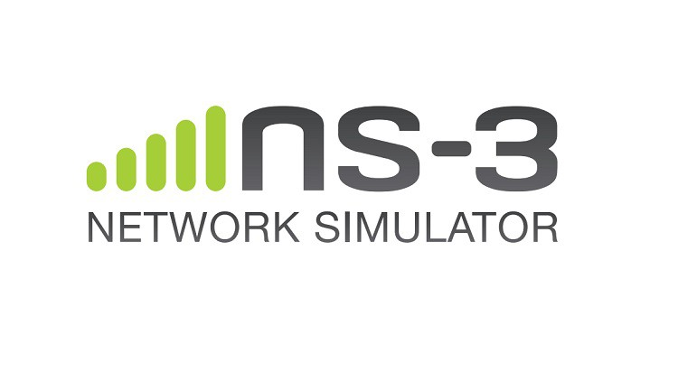
Comparative Study of BBR Congestion Control Algorithm Versions Using the ns-3 Network Simulator
Congestion control is central to Internet performance. The Bottleneck Bandwidth and Round-trip time (BBR) algorithm, developed by Google, departs from traditional loss-based approaches and instead models network bottleneck bandwidth and RTT. BBRv1 improves throughput and latency but has fairness issues, which BBRv2 attempts to address.ns-3, a discrete-event network simulator, is widely used in academic and industry research to evaluate protocol behavior under controlled conditions. This project leverages ns-3 to systematically compare BBR versions and investigate how their design choices affect performance.
Objectives:
Simulate and compare BBRv1 and BBRv2 congestion control algorithms using the ns-3 network simulator
Evaluate their performance across different network topologies, traffic patterns, and link characteristics.
Analyze trade-offs in throughput, latency, convergence time, fairness, and link utilization.
Understand the suitability of BBR versions for real-world deployment scenarios.
Supervisor: Jose Yallouz <jose@technion.ac.il>
Prerequisites: COMPUTER NETWORKS AND INTERNET 1 (044334)

Slide 23
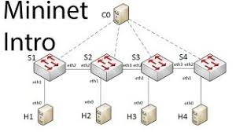
Experimental Comparison of TCP Congestion Control Algorithms Using Mininet
TCP congestion control is essential for maintaining stability and performance on the Internet. Over the years, many algorithms have been proposed and implemented in operating systems, each optimized for specific network characteristics.Popular TCP variants like Reno, CUBIC, and BBR differ significantly in their congestion detection and control strategies. Mininet provides a lightweight, flexible platform for real-time emulation of network topologies, making it ideal for evaluating TCP performance in controlled environments. This project aims to systematically compare these variants, understand their trade-offs, and produce guidelines for their deployment in real-world scenarios.
Objectives:
Set up a network emulation environment using Mininet to test TCP congestion control algorithms.
Evaluate and compare the behavior of different TCP variants (e.g., Reno, CUBIC, BBRv1, BBRv2) under various network conditions.
Analyze performance metrics such as throughput, latency, packet loss, fairness, and convergence time.
Provide insights into the practical suitability of each TCP variant for different network scenarios.
Supervisor: Jose Yallouz <jose@technion.ac.il>
Prerequisites: COMPUTER NETWORKS AND INTERNET 1 (044334)

Slide 24

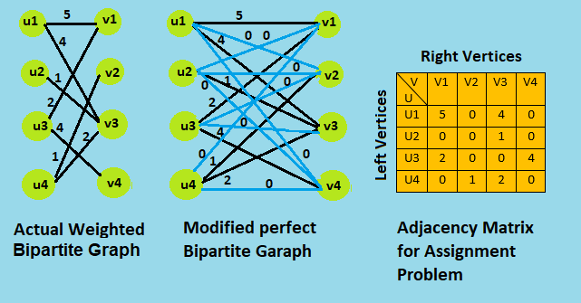
Enhancing the Performance of the Hungarian Algorithm Using Graph Neural Networks (GNNs)
The Hungarian algorithm is a well-known combinatorial optimization method for solving the assignment problem in polynomial time. However, its performance can be limited when dealing with large-scale or real-time applications, such as in logistics, scheduling, and computer vision. Graph Neural Networks (GNNs) have demonstrated remarkable capabilities in learning patterns from graph-structured data, potentially providing an opportunity to improve the efficiency of the Hungarian algorithm. This project aims to investigate how GNNs can enhance the performance of the Hungarian algorithm by reducing computational complexity and improving scalability.
Objectives:
To analyze the computational bottlenecks of the Hungarian algorithm.
To design and implement a GNN-based approach for approximating optimal assignments.
To compare the performance of the traditional Hungarian algorithm with the GNN-enhanced version in terms of speed, accuracy, and scalability.
To explore real-world applications where the enhanced algorithm can be deployed effectively
Supervisor: Ilay Yavlovich <ilayy@campus.technion.ac.il>
Prerequisites: Deep Learning (046211)

Slide 25

Building a Simplified HTTP/3 Client/Server with QUIC in C
The objective of this project is for students to design and implement a simplified version of the QUIC transport protocol and HTTP/3 application protocol in C, and then demonstrate communication between a client and server. The client should be able to send HTTP/3 requests, and the server should be able to process and respond. Unlike using existing implementations, this project focuses on learning by building. Students will implement the protocol stack themselves, including packet structure, basic stream multiplexing, and reliable/secure communication over UDP. By the end of the project, they will gain a deeper understanding of how modern internet protocols are designed and why HTTP/3 and QUIC differ from their predecessors.
HTTP/3 is the most recent version of HTTP, using QUIC as its transport. It supports multiplexed streams, low-latency connection setup, and built-in encryption. For this project, students will implement a reduced version of HTTP/3, focusing on request/response messaging and stream identifiers.
QUIC replaces TCP with a transport protocol built on UDP. It includes features like: Reliable, ordered delivery (per stream, not per connection), Multiplexed streams to avoid head-of-line blocking, Connection setup with reduced round trips, TLS 1.3 encryption by design (students may simplify this layer).
Project Steps
1. Implement a simplified QUIC transportss
2. Implement a minimal HTTP/3 layer
3. Build a client and server in C
4. Experiment and evaluate.
Supervisor: Daniel Levitan <dlevitan@gmail.com>
Prerequisites: COMPUTER NETWORKS AND INTERNET 1 (044334)

Slide 26
Development of a Scanner for QUIC Server Misconfiguration Detection
The QUIC protocol (Quick UDP Internet Connections) has rapidly gained popularity as a transport layer protocol due to its improved performance, low latency, and built-in encryption. Companies such as Google, Cloudflare, and others have widely adopted QUIC, and it is now a key component of HTTP/3. However, with the growing adoption of QUIC, the complexity of its configuration on servers increases. Misconfigurations can lead to performance degradation, security vulnerabilities (e.g., improper TLS setup, weak cipher suites, incorrect 0-RTT handling), or even service unavailability. While tools for scanning and detecting misconfigurations in HTTP, TLS, and other protocols exist, there is a relative lack of comprehensive open-source tools focused on QUIC server misconfiguration detection.
The objective of this project is to design and implement a scanner that detects common misconfigurations in QUIC servers. Specifically, the scanner will:
Establish QUIC connections to target servers.
Retrieve and analyze server configuration details (e.g., TLS parameters, supported versions, 0-RTT support, etc.).
Detect known misconfigurations and insecure settings.
Generate detailed reports to assist system administrators in identifying and mitigating configuration issues.
Supervisor: Sorana Fraier <sf10095@gmail.com>
Prerequisites: COMPUTER NETWORKS AND INTERNET 1 (044334)

Slide 27
Mitigation of QUIC Vulnerability
QUIC (Quick UDP Internet Connections) is a modern transport protocol designed to enhance performance, security, and reliability compared to TCP. While QUIC offers built-in encryption and improved connection management, misconfigurations in QUIC implementations can introduce security vulnerabilities, such as weak encryption, improper handshake settings, and incorrect congestion control mechanisms. This project aims to develop a tool designed to detect misconfigurations and security risks in QUIC deployments. The scanner will help security analysts, system administrators, and researchers identify weaknesses that could lead to downgrade attacks, data leakage, or performance issues.
Objectives:
Analyze the QUIC protocol to identify potential security vulnerability.
Detect common misconfigurations, including:
Downgrade attack
Weak or outdated cryptographic settings.
Improper handshake implementation.
Lack of replay protection.
Incorrect congestion control settings.
Generate detailed security reports with recommendations for mitigation.
Supervisor: Sorana Fraier <sf10095@gmail.com>
Prerequisites: COMPUTER NETWORKS AND INTERNET 1 (044334)

Slide 28
Development of a Client-Server Application for NTP over QUIC
The Network Time Protocol (NTP) is one of the oldest Internet protocols, designed to synchronize clocks across computer systems. Precise time synchronization is essential for numerous applications, including distributed systems, security protocols, financial transactions, and telecommunication networks.Traditional NTP runs over UDP and is susceptible to certain vulnerabilities, such as amplification attacks, packet spoofing, and limited support for confidentiality and integrity. As the Internet evolves toward protocols that emphasize security and performance, QUIC (Quick UDP Internet Connections), which combines transport and cryptographic layers into a single protocol, presents a promising alternative.Running NTP over QUIC can provide:
Built-in encryption and authentication via TLS 1.3.
Resistance to spoofing and certain types of DoS attacks.
Improved congestion control and recovery.
Support for reliable message delivery where necessary.
The aim of this project is to explore and demonstrate how NTP can be implemented over QUIC, by developing a prototype client-server application.2. Project Goals:Design a time synchronization protocol that operates over QUIC, as follows:
Develop both client and server implementations.
Demonstrate the advantages of running NTP over QUIC in terms of security, reliability, and performance.
Evaluate the feasibility and potential limitations of deploying NTP over QUIC.
Supervisor: Sorana Fraier <sf10095@gmail.com>
Prerequisites: COMPUTER NETWORKS AND INTERNET 1 (044334)

Slide 29
Development of a Client-Server Application for FTP over QUIC
The File Transfer Protocol (FTP) has been a standard protocol for file transfer for decades. Despite its wide adoption historically, FTP in its traditional form suffers from several weaknesses:
Lack of built-in encryption (addressed partially by FTPS and SFTP).
Connection management complexity (separate control and data connections).
Vulnerability to firewall and NAT traversal issues.
Poor performance over high-latency or lossy networks.
With the rise of modern transport protocols like QUIC (Quick UDP Internet Connections), originally developed by Google and standardized by IETF (RFC 9000, RFC 9001), it is now possible to rethink classic application protocols like FTP. QUIC provides:
Integrated encryption and authentication (TLS 1.3).
Multiplexed streams over a single connection (eliminating the need for multiple TCP connections).
Improved performance with better congestion control.
Built-in NAT traversal support.
This project aims to design and implement a modernized FTP-like file transfer protocol that operates entirely over QUIC, simplifying connection management and improving performance and security, as follows:
Design a client-server file transfer application that mimics FTP functionality over QUIC.
Implement both client and server components.
Demonstrate improved performance, simplicity, and security compared to traditional FTP.
Evaluate the challenges and trade-offs of adapting legacy protocols to modern transport layers.
Supervisor: Sorana Fraier <sf10095@gmail.com>
Prerequisites: COMPUTER NETWORKS AND INTERNET 1 (044334)

Slide 30

Development of a Scanner for TLS 1.3 Server Misconfiguration Detection
TLS 1.3 (Transport Layer Security, RFC 8446) is the latest version of the TLS protocol, offering significant improvements in security, privacy, and performance over previous versions. It eliminates outdated cryptographic primitives, reduces handshake latency, and enhances forward secrecy by design.Despite these improvements, misconfigurations in TLS 1.3 servers can still leave systems vulnerable to a wide range of threats — such as weak certificate chains, improper key reuse, incorrect cipher suite negotiation, or insecure fallback mechanisms. Proper configuration is critical for ensuring both the security and reliability of services that depend on TLS 1.3. Currently, there are limited tools that specifically focus on TLS 1.3 misconfigurations, as many existing scanners are still designed primarily for TLS 1.2 and earlier versions. This project seeks to fill that gap by developing a scanner focused on detecting TLS 1.3-specific server misconfigurations.
The main objective of the project is to design and implement a scanner that:
Establishes TLS 1.3 connections to target servers.
Retrieves and analyzes server-side TLS 1.3 configuration details.
Detects common misconfigurations and insecure deployments.
Generates comprehensive reports to assist administrators in identifying and correcting weaknesses.
Supervisor: Sorana Fraier <sf10095@gmail.com>
Prerequisites: COMPUTER NETWORKS AND INTERNET 1 (044334)

