Slide 1
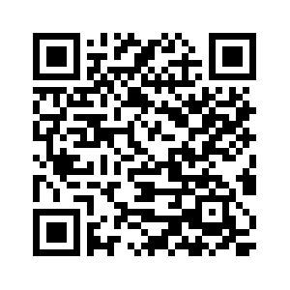
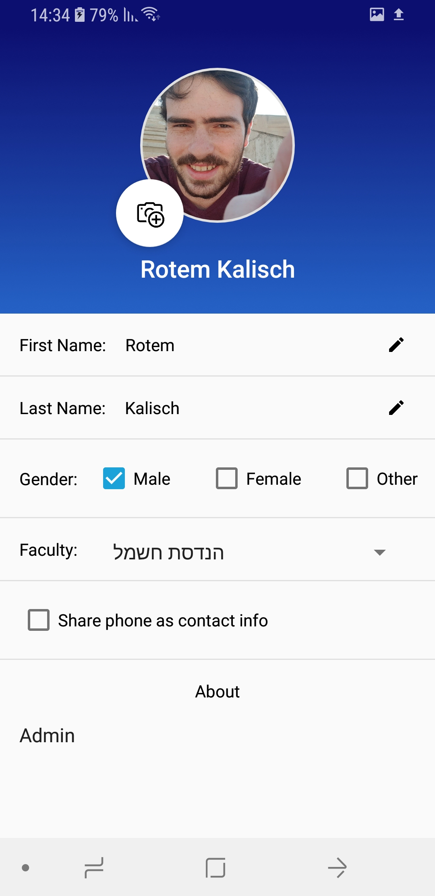
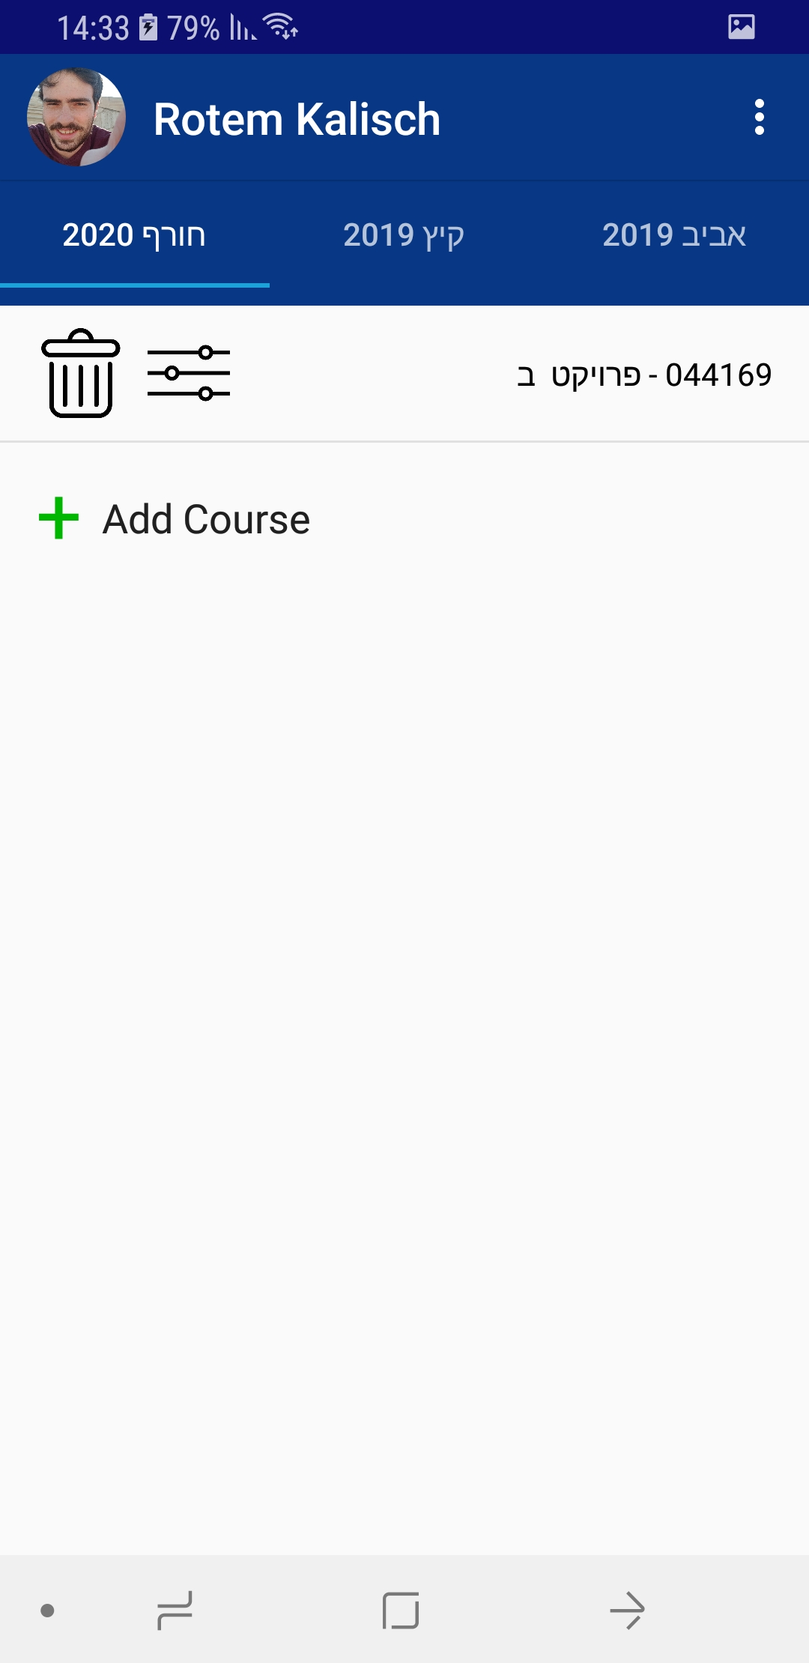
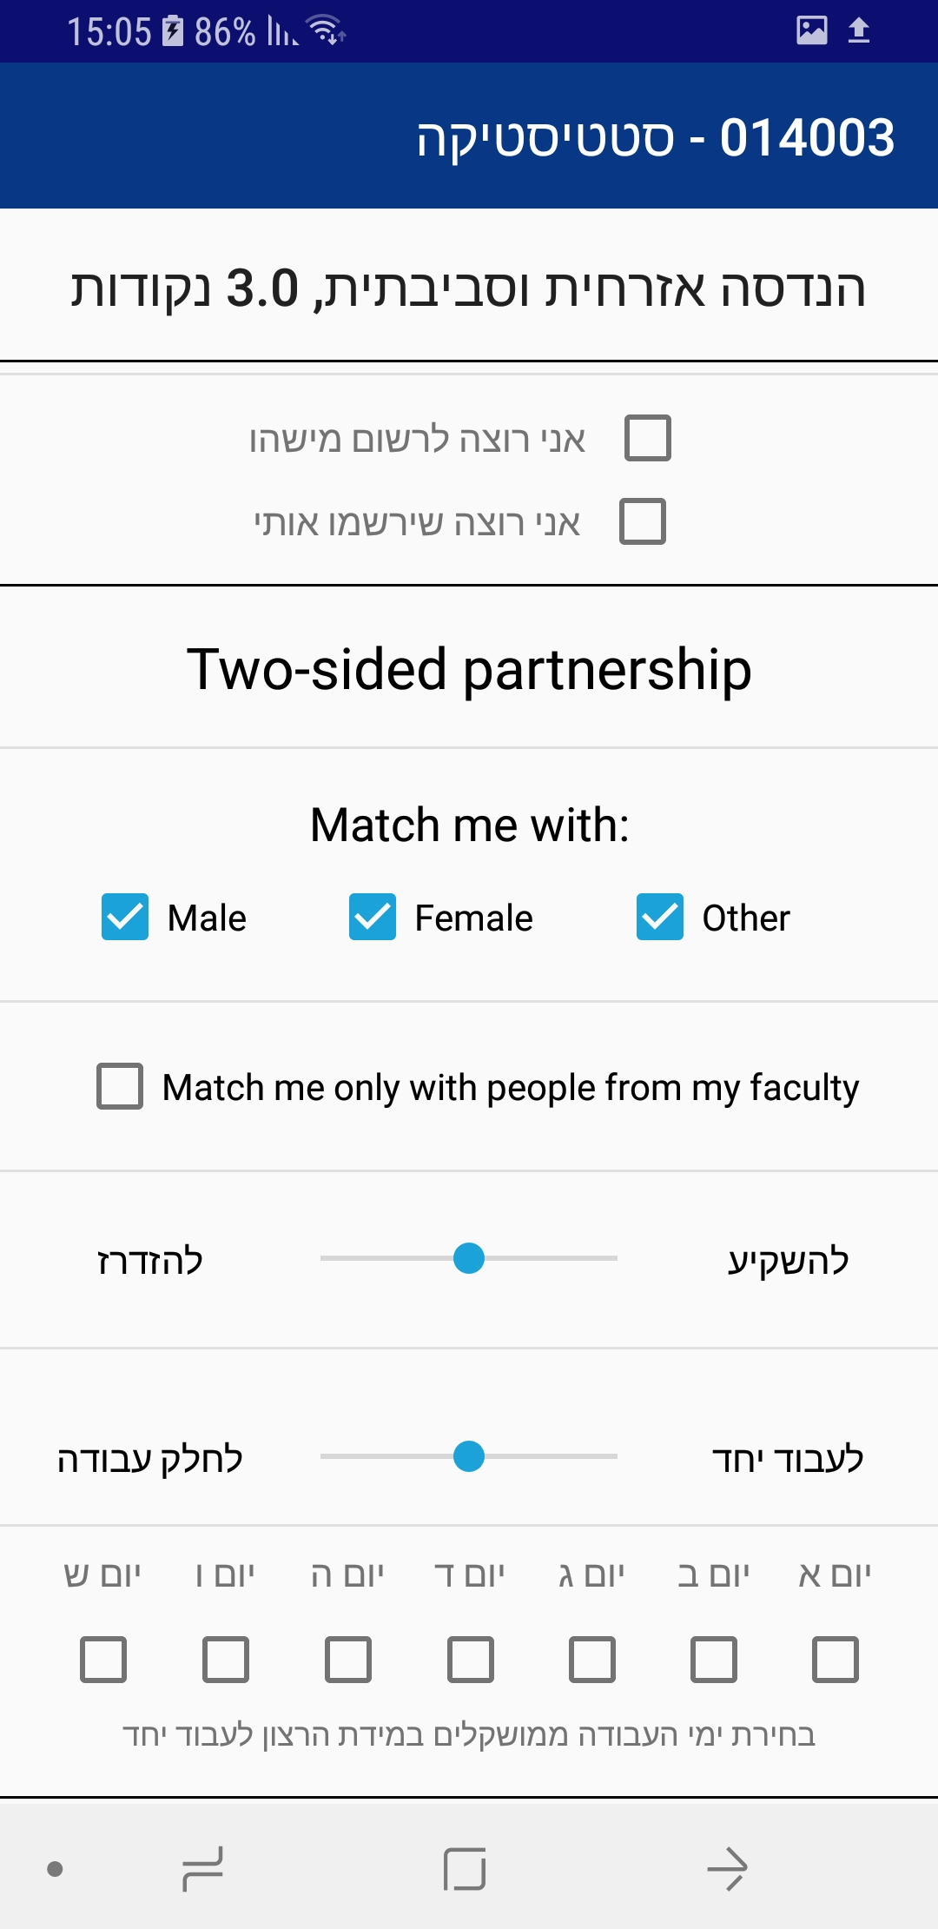
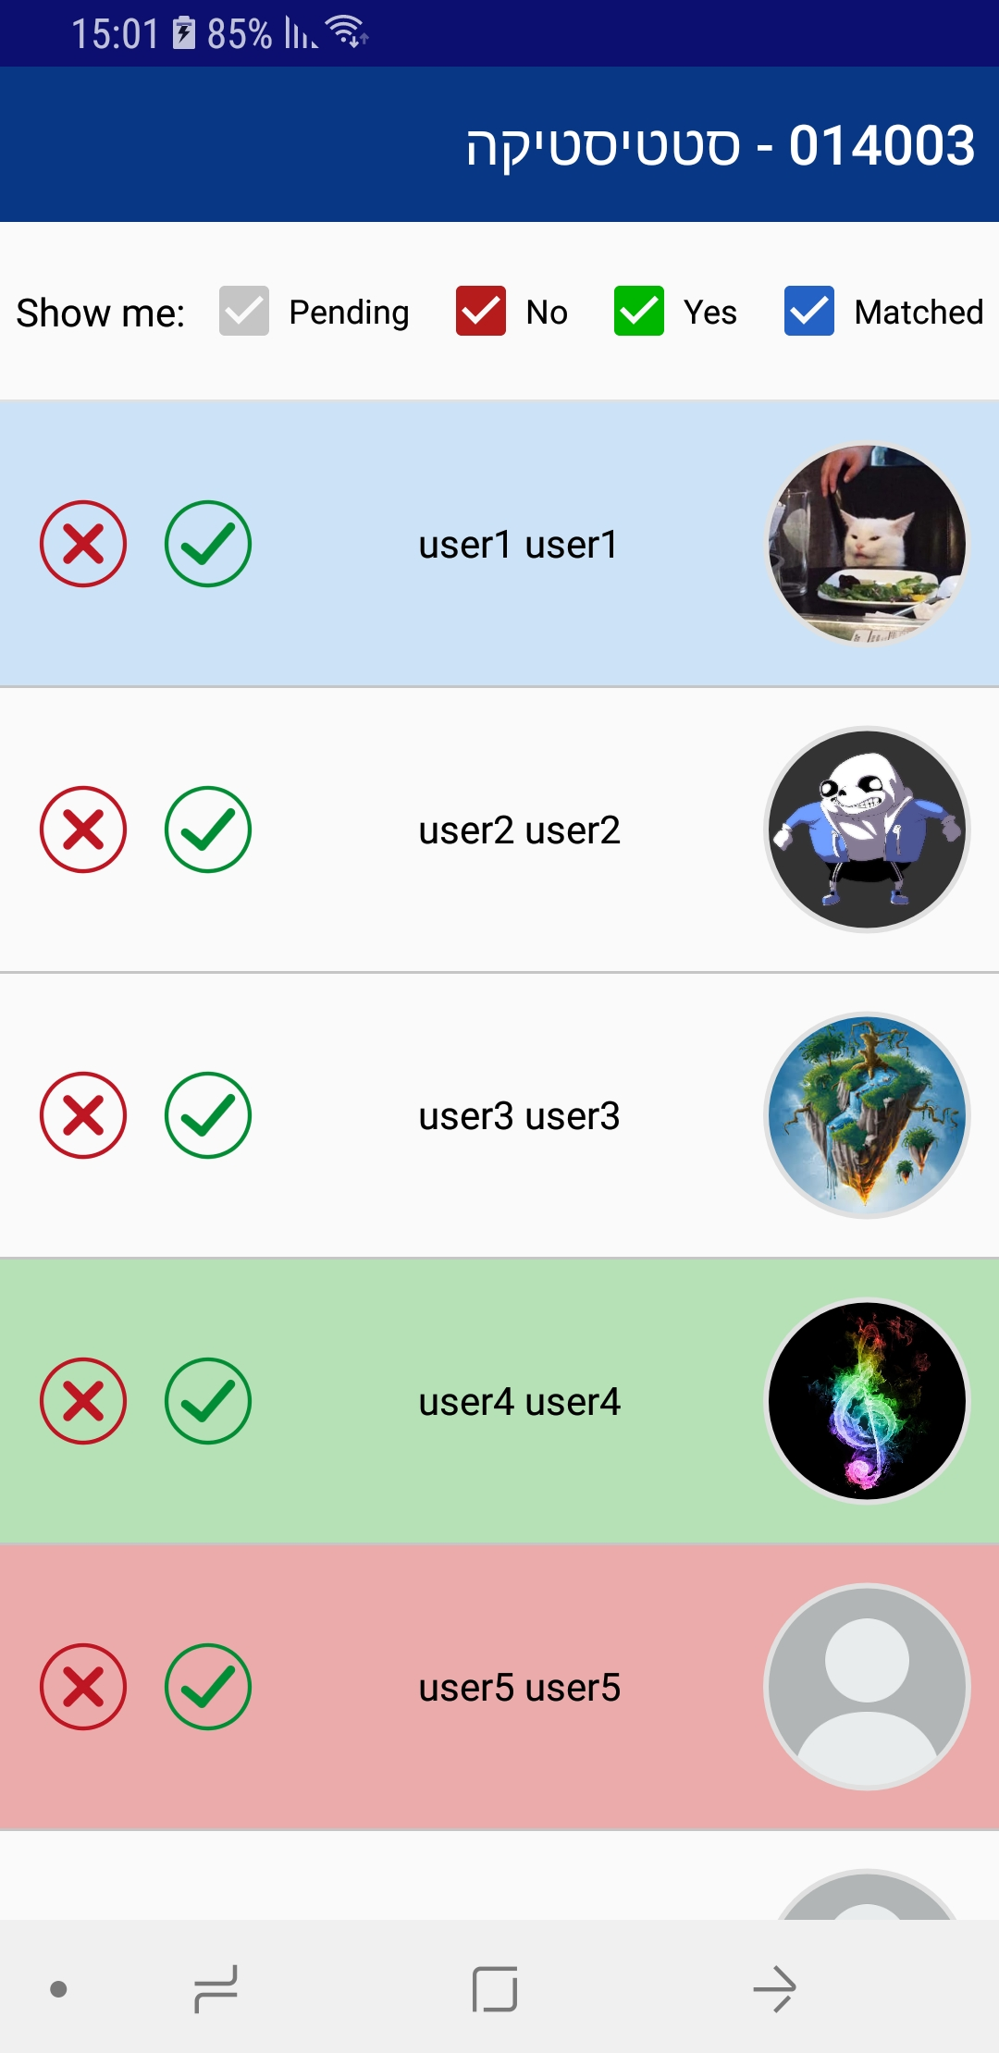
Networked Software Systems Lab
Electrical Engineering | Technion
TechMate
An application for finding partners in the Technion!
Arielle Fridman, Rotem Kalisch
Supervisor: Viktor Kulikov
Scan to view on google play!
Introduction
Finding partners for courses assignments and projects through common social networks is sometimes inconvenient.
TechMate introduces an alternative platform, where users can find their ideal partners privately.
Challenges
Designing from scratch a whole application
New programming languages and environments
Finding an appropriate matching algorithm
Rolling out to production in the Technion!
Goals
Build an easy to use app
Different user preferences for each course
Private matching
Technion account sign-in
Find the ideal partners
Maintenance
Reports on bugs and other users
Contact email: TechMate.Technion@gmail.com
Automatic DB backup daily script
Automatic daily script for fetching new courses from the UG site.

