Slide 1
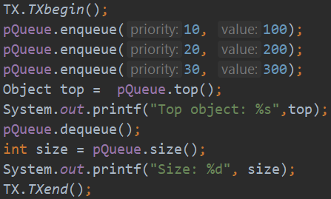
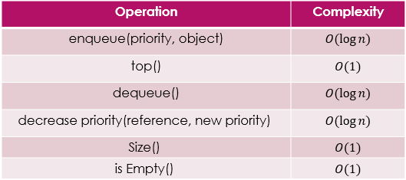
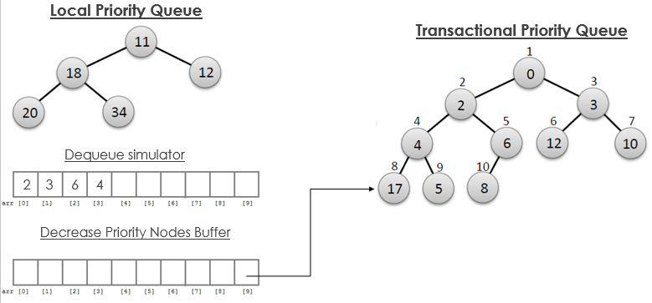
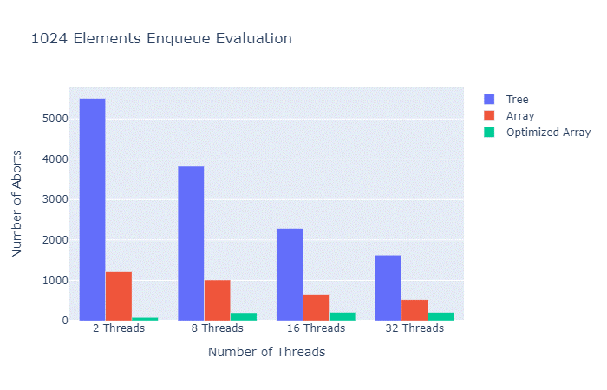
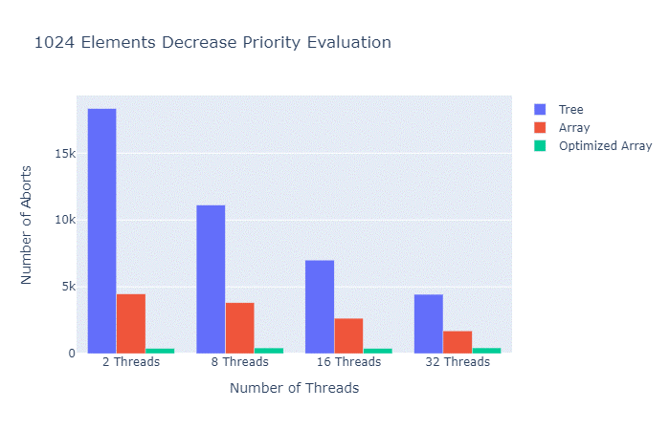
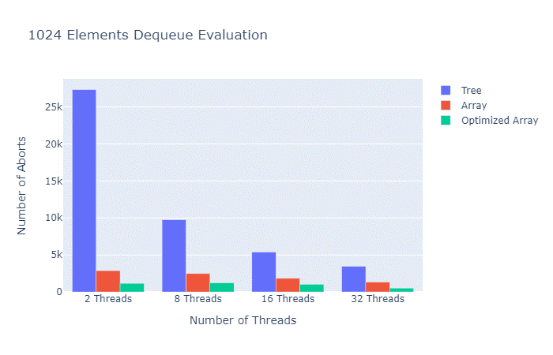
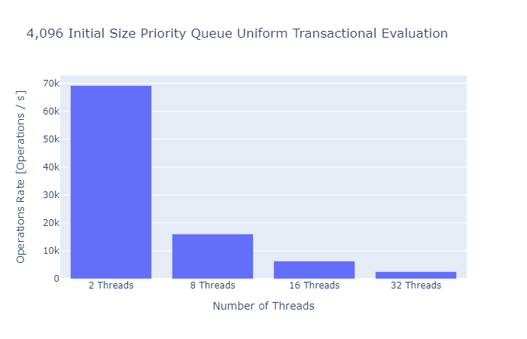
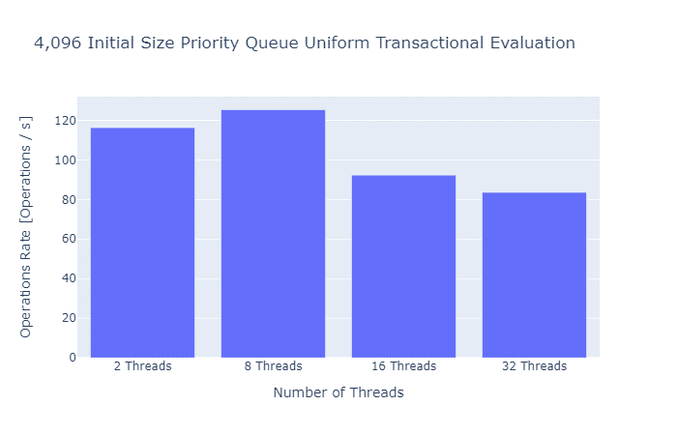
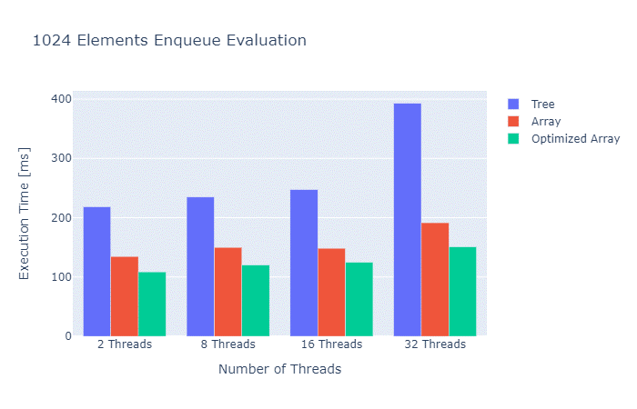
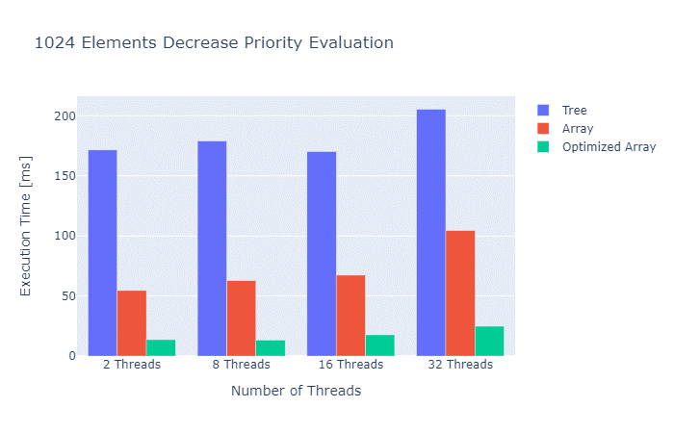
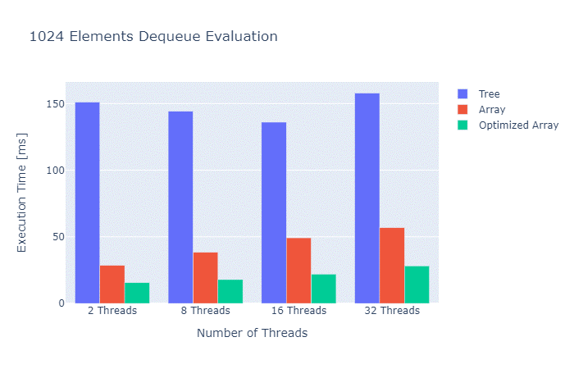
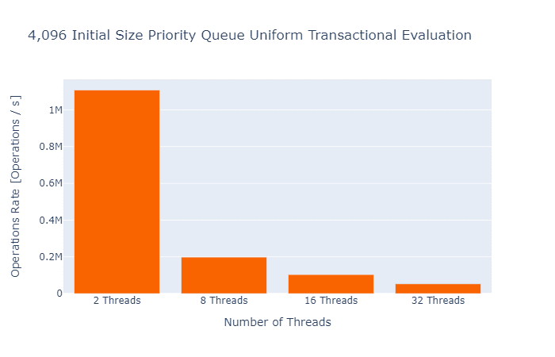
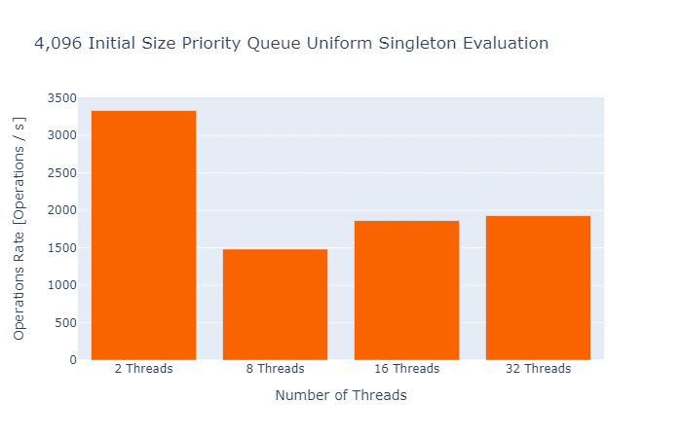
Transactional Priority Queue
Ido Yehezkel & Ron Hirsch Supervised by Gal Assa
Project Goals
Main goal: add a transactional priority queue to TDSL.
Evaluate performance.
Implement as “pure” ADT, and then using Java’s priority queue.
Side goals:
Learn about transactional memory.
Develop multithreading programing skills.
Introduction – TDSL
Transactional Data Structure Libraries. Introduced in 2016 by Spiegelman et al.
Provide transactional semantics to multiple accesses to data structures.
Unlike concurrent data structure libraries
TDSL offers efficient and scalable transactions.
Singletons are supported and perform at the speed of the original data structure library.
Similar to concurrent data structure libraries.
Transactional Semantics
New transactions are created by TXBegin().
TXEnd() marks the end of a transaction and tries to commit all operations (throws an abort exception upon failure).
To satisfy isolation and atomicity, modified objects are locked, and the transaction is validated prior to commit.
Minimum Priority Queue
Minimum Priority queue(MPQ) is an abstract data type, similar to a regular queue data structure, but MPQ is sorted by elements’ priorities.
In an MPQ, the lowest priority element is always stored as the head of the queue.
Challenges
Enqueue new elements to the MPQ without modifying it.
Where and how should it be stored ?
Dequeue elements from the MPQ without modifying it.
How all dequeues take effect when transaction commits?
How to retrieve the $k^{th}$ lowest priority element?
Decreasing an element’s priority in isolation.
How to keep original priority elements but also make decrease?
How to reflect to shared memory when transaction commits?
Project Evolution
Take 1 – Tree
Take 2 - Array Based
Take 3 – Array Based with Merge Optimizations
Benchmarks
We wanted to evaluate our best implementation with known benchmarks.
(A Skiplist-Based Concurrent Priority Queue with Minimal Memory Contention, Linden and Jonsson)
We evaluate our priority queue with 2 scenarios and initial size of 4,096 elements.
We used a 32 core machine.
Summary
We designed and implemented a transactional PQ in 3 ways.
Our design exposes same API as other PQs. Transactional semantic are provided "under the hood“.
We evaluated all three implementations and provided results and code coverage.
Follow - up
Implementing PQ using TDSL's skip-list should be considered.
Relaxed Priority Queue.
Supporting nested transactions.
Project Sponsors:

