Slide 1
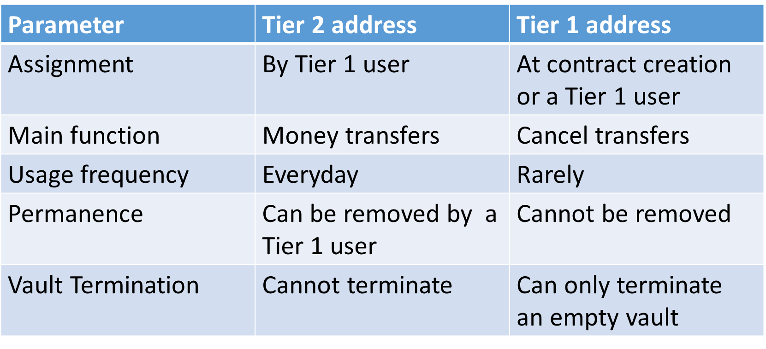
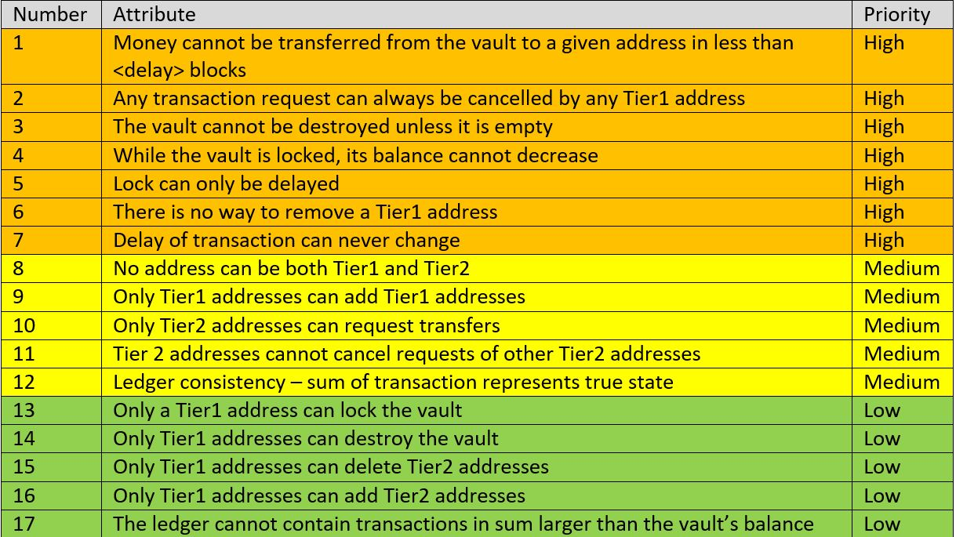
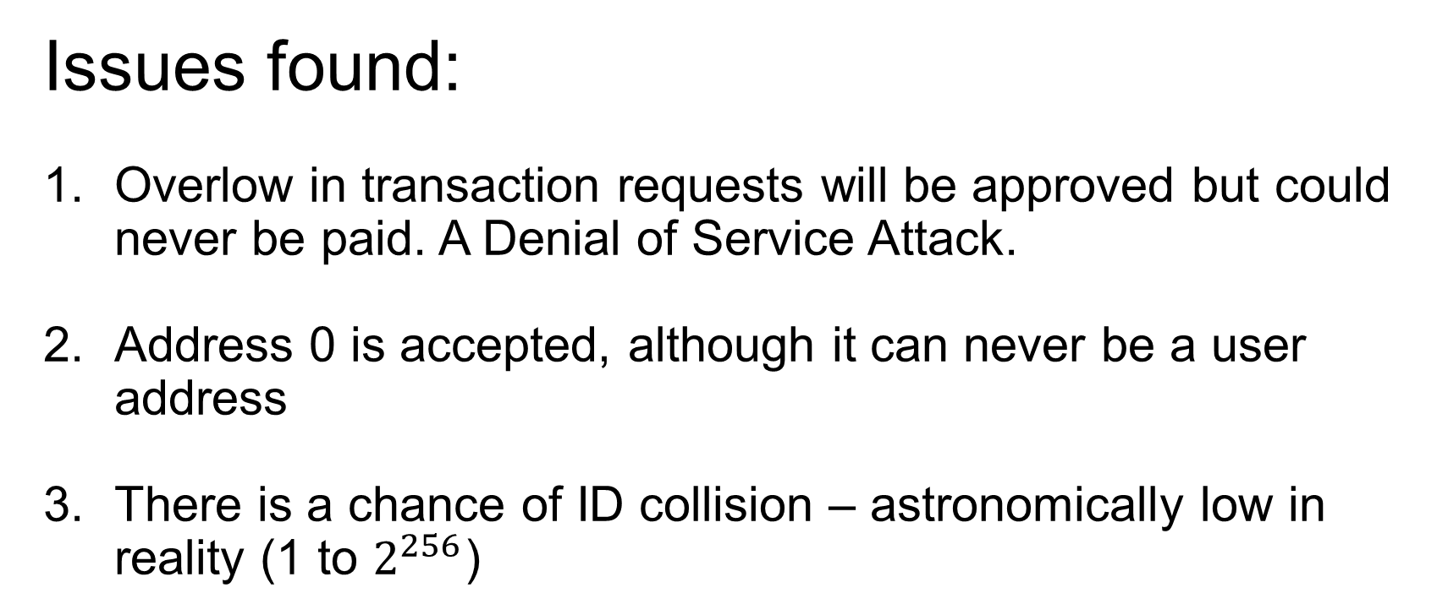
Ethereum Vault
Uri Kirstein Supervised by Michael Mirkin
Cryptographic coin keys are the asset
Lose the key – Lose the asset
Anyone
Tier 2
Anyone
In the vault, each payment is delayed. During that time a privileged tier one user can veto the transaction.
As every payment can be vetoed, there is no incentive for a thief to steal the keys of the vault users.
Anyone
Tier 2
Anyone
Tier 1
Vault
Balance
Ledger
Timed Lock
Contract members:
Tier 1 user list
Tier 2 user list
Time delay
Payment instances
Total pending payments
Payment from the vault is done in two steps (with waiting time in between)
Tier two address
Request
Vault
While the vault is locked, money cannot leave the vault. Vault timer can only increase.
Ledger is a different library that is deployed before the vault contract and linked into.
Each transaction record includes the recipient’s address, amount of money to transfer, initiator (which can cancel it), ID and timestamp in block number.
Anyone
Commit
Vault
Formal Verification
Issues found:
Overlow in transaction requests will be approved but could never be paid. A Denial of Service Attack.
Address 0 is accepted, although it can never be a user address
There is a chance of ID collision – astronomically low in reality (1 to $2^{256}$)
With help from Shelly Grossman of Certora

