Slide 1


AWS Manager
FDR
Networked Software Systems Lab
Students: Edward Srouji
Firas Jahjah
Instructor: Roy Mitrany
Semester: Winter, 2017

Slide 2

Introduction
AWS is a secure cloud services platform.
  Offers compute power, database storage, and other functionality to help businesses scale and grow.
  A platform for virtually every use case.
To fully utilize AWS, the account manager has to:
  Manage AWS Resources
    Track usage
    Track expenses
  Manage users
    Different budgets for different groups of users
    Limit permissions (security)
COMPLICATED
Notes:
AWS הוא אתר לשירותי מחשוב בענן
נותן הרבה שירותים הקשורים למחשוב אחסון וכל מה שניתן לעשות בענן, ונותן פתרון לכמעט כל מקרה
וכדי שנוכל לנצל את מיטב כוחות AWS, אנחנו צריכים לעקוב אחרי כל השימושים שלנו וכל ההוצאות.
ומצד שני, עבור קבוצות של אנשים שמשתפים את התקציבים, חשוב מאוד לשמור את איזון בין הקבוצות, ולחלק את התקציבים ולהגביל את הרשאות הגישה

Slide 3

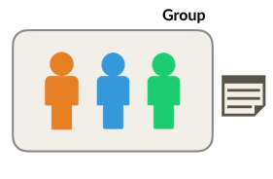







AWS Access Management
Identity and Access Management (IAM)
  A web service that helps securely control access to AWS resources, and manage who is authenticated and authorized to use resources.
  IAM Users
  IAM Policies
  IAM Groups
  IAM Roles
Notes:
With AWS IAM you get to control who can do what in your AWS environment and from where
אחד השירותים הניהוליים ש- AWS מספקת הינו IAM...
User IAM ניתן להגדיר משתמשים חדשים שהם נמצאים מתחת לאותו חשבון (account)
IAM Policies פוליסות, שהם בעצם אוסף הרשאות שניתן להצמיד למשתמשים שאנו יוצרים
IAM Groups ניתן ליצור קבוצות שמוצמד להם פוליסות, ול- groups ניתן להכניס משתמשים כך שכולם יקבלו אותם פוליסות הצמודות לקבוצה.
IAM Roles – אנחנו פחות ניכנס לזה, אבל בגדול ניתן להגדיר תפקידים עם הרשאות מסוימות. התפקידים ניתן להצמיד למשתמשים חיצוניים (ב- account אחר) , ולשירותים שונים (אפשר לתת דוגמא על lambda function)

Slide 4



Use Case Example
AWS Account
Permissions A
✔ Launch new instances
✔ Write in databases
✖ Delete database
✖ Create new users
…
Permissions B
✔ Launch new instances
✔ Write in databases
✔ Delete database
✔ Create new users
✔ …
Sample Group
Admins Group
Bob
Alice
Susan
Nate
Can launch new instances, but
Can’t delete databases, and so on.
Has full access to AWS.
Bob
Nate
Notes:
כדי להבהיר את חשיבות הניהול נסתכל על סינריו הבא

Slide 5
Policies Creation
Option 1: Select from AWS’s huge set of pre-made policies.
  Easy to use.
  Satisfies basic needs.
  As needs become more specific, you will have to create your own!
Option 2: Create your own customized policy.
  Choose from hundreds of services, actions and resources.
    Mix and match.
    Using either visual editor or JSON.
  Can be fully customized for every need.
Notes:
AWS מציעה שתי שיטות ליצירת פוליסות להרשאות
הראשונה היא בחירה מסט של פוליסות ש-AWS מתחזקת.
היתרון של שיטה זו הוא שהוא קל לשימוש ועונה על הצרכים הבסיסיים

Slide 6
Policies Creation
Option 1: Select from AWS’s huge set of pre-made policies.
  Easy to use.
  Satisfies basic needs.
  As needs become more specific, you will have to create your own!
Problem:
  Lists can be very long ⇒ hard to get what you want.
  Too general ⇒ Less secure.
Notes:
הרשימות יכולות להיות ארוכות מדי
וככל שהשימוש ב-AWS מתקדם, יש צורך בפוליסות הרשאות מתוחכמות יותר, ועדינות יותר

Slide 7
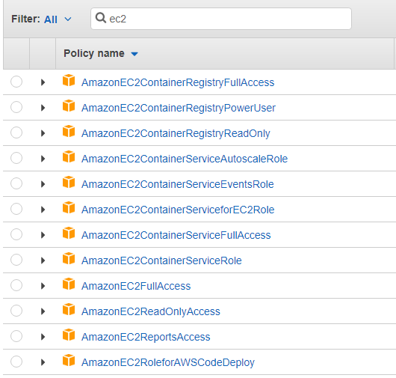
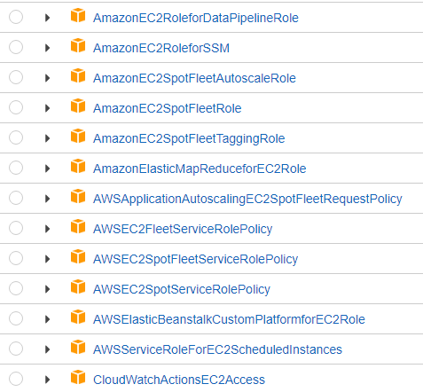
Problem: Policies Complication

Slide 8
Policies Creation
Option 1: Select from AWS’s huge set of pre-made policies.
  Easy to use.
  Satisfies basic needs.
  As needs become more specific, you will have to create your own!
Option 2: Create your own customized policy.
  Choose from hundreds of services, actions and resources.
    Mix and match.
    Using either visual editor or JSON.
  Can be fully customized for every need.
Notes:
השיטה השנייה ליצירת הפוליסות היא יצירה ידנית של כל ההרשאות והרכבה אישית של כל מרכיבי הפוליסות הכוללים סוג השירות, הפקודות, המשאבים וכו'
ניתן לעשות זאת ע"י עורך וויזואלי, או הקלדה בפורמט JSON

Slide 9
Policies Creation
Option 2: Create your own customized policy.
  Choose from hundreds of services, actions and resources.
    Mix and match.
    Using either visual editor or JSON.
  Can be fully customized for every need.
Problem:
  Can get too ugly.
  Too many variables to control.
Notes:
יכול להפוך למשהו מכוער בקלות
מכיל הרבה פרמטרים

Slide 10
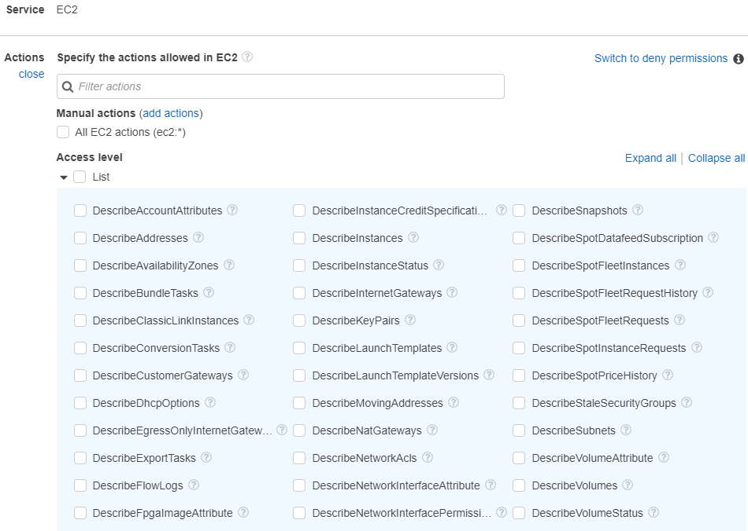
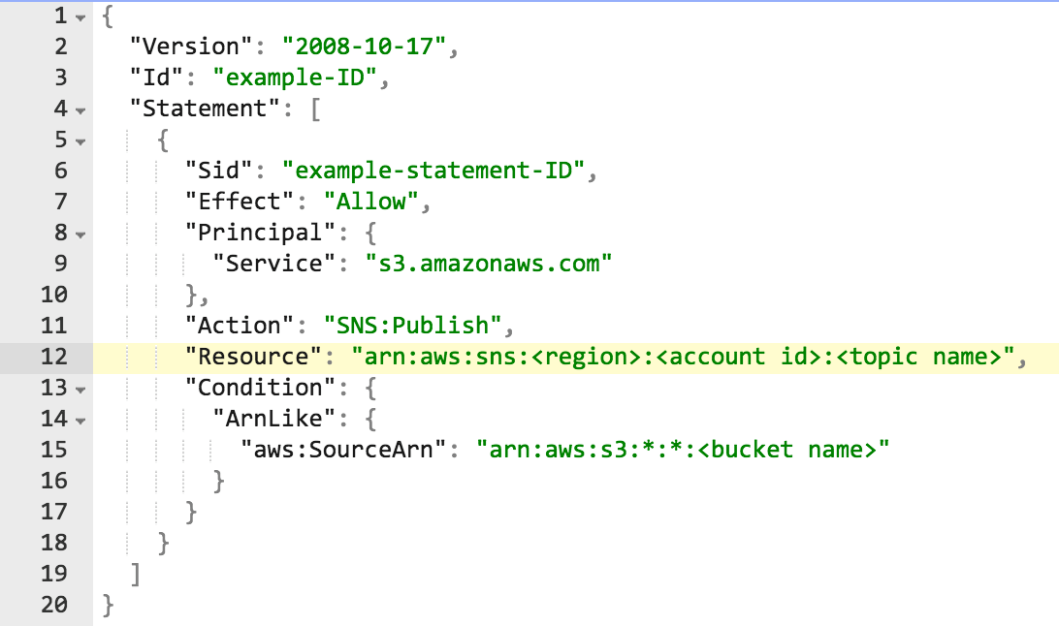
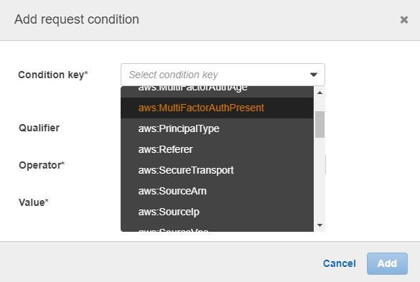
Problem: Policies Complication

Slide 11

Solution: Simple Webpage
Simple webpage with easy to use UI
  All the basic needs in one place
    Create new IAM Groups with simplified policies.
    Create new IAM Users and attach them to group(s).
    Assign Group Budgets.
  Show tracked usage and expenses
    More on that later.
  Secure access
    Using AWS Cognito.

Slide 12





Webpage: Design Structure
AWS Manager - Web
Sign-in
Token
Amazon Cognito
AWS Lambda
…
Create IAM group
Create IAM user
Attach/detach users
Update/Get budgets
Budgets Table
IAM
Notes:
After we receive an authentication token, every request to AWS goes through temporary aws credentials.
Every request done in the front-end is handled by a lambda function in the back-end.

Slide 13

AWS Manager

Slide 14
Budget Creation
AWS provides budget creation:
  Sends alerts on certain threshold.
  Monitor budgets on specific services.
Problems
  It takes 24-hours to update and send alerts.
    Might cause huge losses to heavy users who forget expensive instances!
  Hard and tiring to monitor budgets per groups.
    Need to manually tag each instance and resource.
    Prone to inconsistency due to human mistakes.

Slide 15

Amazon CloudWatch
Can monitor: CPU, data transfer and disk usage activities.
Collect and track metrics configurations.
Automatic alarms/reactions on selected changes.
Customizable graphs and statistics.
Notes:
Monitoring service

Slide 16
Solution: Realtime Java Monitor
Monitors group budgets in real-time.
Automatically registers CloudWatch Metrics Data.
  Real-time data expenses.
  Can be viewed in customizable graphs provided by AWS.
    View aggregated charges.
    View minute-by-minute estimated charges.
  Monitored usages are provided separately for each group.
Notes:
Metrics resolution is one minute.
Purpose:
Store custom metrics per group.
Each metric describes the estimated money spent for that group.

Slide 17




Monitor: Design Structure
AWS Monitor - App
Email
Amazon
DynamoDB
Amazon CloudWatch
(Custom metrics per group)
Read/
Write
Read
Read
Budgets Table
Instance Owners Table
Instance Prices Table
Notes:
Java code that runs on t2.micro instance – best to run 24/7
Uses AWS Java SDK

Slide 18



How do we detect instances’ owners ?
User Action
Triggered event
Write
Amazon EC2
Run Instance
Amazon CloudWatch
Register instance owner
Instance Owners Table
AWS
CloudTrail
Notes:
First, need to talk about CloudTrail
למזלנו שם נמצא השם של מי שהפעיל המכונה, ובכך אנחנו יכולים לקשר בין כל מכונה לבין הקבוצה שצריכים לחייב
ופה נמצאת הנקודה העדינה שמקשרת בין שני הפתרונות שלנו: ה-"ויב" והמוניטור

Slide 19






sends
Diagram
root
Main
Monitor
data volume
Main Region
Java
Running
Tasks
Running
Tasks
Running
Tasks
EC2 instance
data volume
EC2 instance
data volume
EC2 instance
data volume
security group
security group
security group
Region #1
Region #2
Region #n

Slide 20

Manager
A group of students are working on a project
sends
How does it work?
Example
root
The manager of the project allocates a budget of $50
Main
Monitor
data volume
When the main monitor is running:
Detect all of the students’ usages in real-time
Main Region
Estimated charges of every minute are available
$50
Java
When a warning limit is exceeded a notification is sent using SES
Running
Tasks
Running
Tasks
Running
Tasks
EC2 instance
data volume
EC2 instance
data volume
EC2 instance
data volume
security group
security group
security group
Region #1
Region #2
Region #n
Students

Slide 21
Budget Monitor

Slide 22



Notable Used Services
The SDK helps take the complexity out of coding by providing Java APIs for many AWS services.
A web service that helps securely control access to AWS resources, and manage who is authenticated and authorized to use resources.
Java SDK
IAM
A notification service that provides mass delivery of messages.
Object storage built to store and retrieve any amount of data from anywhere.
Amazon
SNS
Amazon
S3
Notes:
SDK – The SDK helps take the complexity out of coding by providing Java APIs for many AWS services.
IAM – Identity and Access Management - A web service that helps securely control access to AWS resources, and manage who is authenticated and authorized to use resources.
SNS – Simple Notification Service that provides mass delivery of messages.
S3 – Object storage built to store and retrieve any amount of data from anywhere.

Slide 23
Notable Used Services (Continued)
Amazon DynamoDB is a fast, flexible and a fully managed cloud NoSQL database service.
Amazon Cognito lets you add user sign-up, sign-in, and access control to your web and mobile apps quickly and easily.
Amazon
DynamoDB
Amazon
Cognito
A compute service that makes it easy to build applications that respond quickly to new information.
AWS CloudTrail is a service that enables governance, compliance, operational auditing, and risk auditing of your AWS account.
AWS
Lambda
AWS
CloudTrail
Notes:
DynamoDB–
Cognito–
Lambda – A compute service that makes it easy to build applications that respond quickly to new information.
CloudTrail–

Slide 24
Gantt Chart
Completed
Break
Discontinued

Slide 25

Thank You!

Slide 26

Motivation
IAM Policies lay the foundation and form the core of “Access” on AWS objects.
Policies should be fine-grained for highest security.
Generating policies just the way you want them could get complicated.
Our project’s second goal is to simplify the process. We offer:
  An easy to use interface to work with groups, policies and users.
  Keep track of groups' budgets.

Slide 27
Motivation (Continued)
AWS offers a wide variety of services.
However, the user is responsible for managing his resources.
Resources translate to money, and no one wants to waste money.
Our project’s first goal is to work as a real-time monitor over EC2 services.
  Faster identification of running over budget.
  Minimize costs.
Notes:
AWS provides alarms and alerts sending mechanism after reaching a specified costs threshold
And allows users to set a specific budget
Problem: it takes ~24hours to get those updates from AWS. Sometimes this is way too much time which would cost us extra wasted money.
Solution: Service monitor (our project)

Slide 28

Amazon EC2
EC2 or Elastic Compute Cloud is a web service that provides resizable compute capacity in the cloud.
Provides complete control of the computing resources.
Provides Auto Scaling tool allowing users to set automatic capacity scaling.
Customizable: multiple instance types, different operating systems and variety of memory, CPU and storage choices.
Reliable & Secure: committed to provide 99.99% availability for each EC2 Region.

